Slide 1

Sustainable Development
Made by Maria Eselevich, KTY C2/1 student

Slide 2
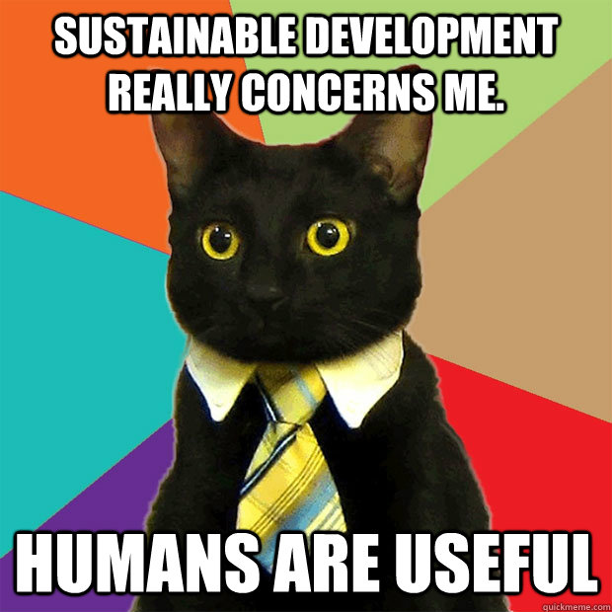
What is Sustainable Development?
Sustainable Development is the development that meets the needs of the present without compromising the ability of future generations.

Slide 3
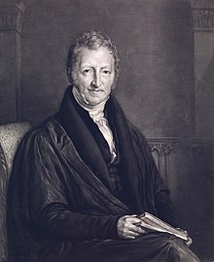
History of the concept
1798 – Thomas Robert Malthus

Slide 4
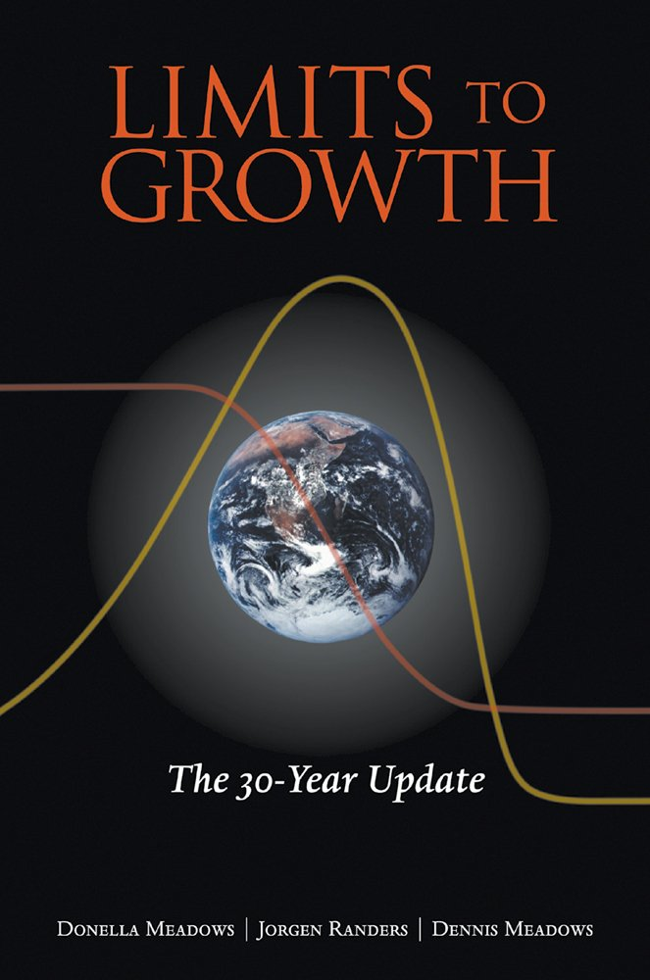

History of the concept
1972 – “The Limits to Growth” by The Club of Rome

Slide 5

History of the concept
1972 – Conference on the Human Environment in Stockholm
Mission: To provide leadership and encourage partnership in caring for the environment by inspiring, informing, and enabling nations and peoples to improve their quality of life without compromising that of future generations.

Slide 6
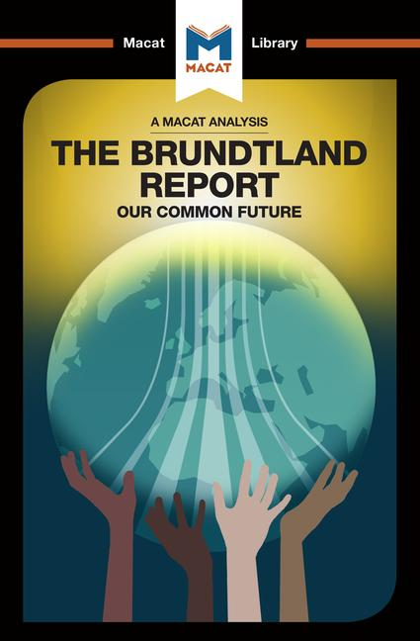
History of the concept
1983 – UN General Assembly
1987 – The Brundtland Report

Slide 7


History of the concept
1992 – the UN Conference on the Environment and Development (UNCED)

Slide 8
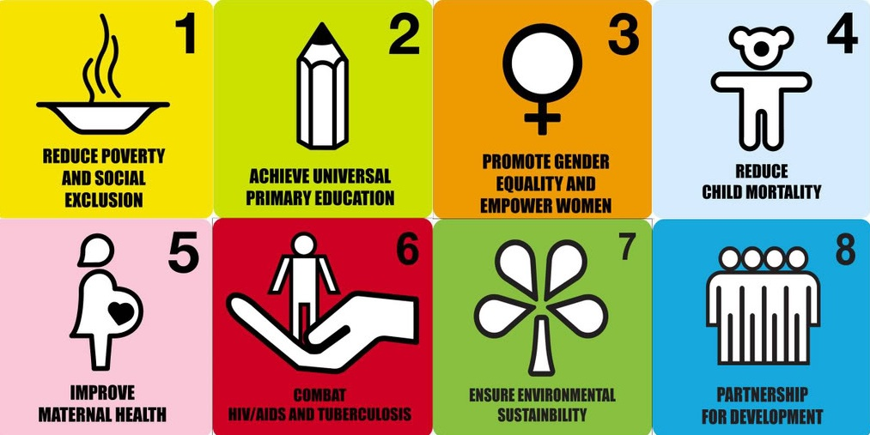
History of the concept
2000 – Millennium Summit in New York
2002 – The World Summit on Sustainable Development (WSSD), Johannesburg

Slide 9
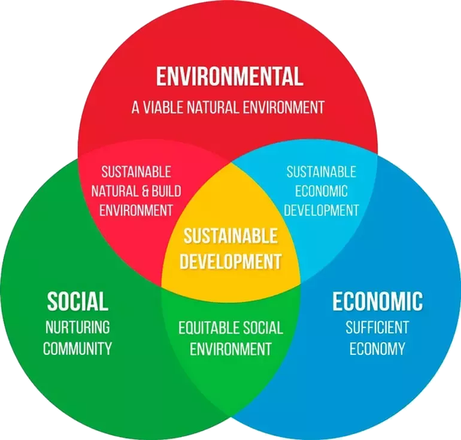
Modern concept

Slide 10
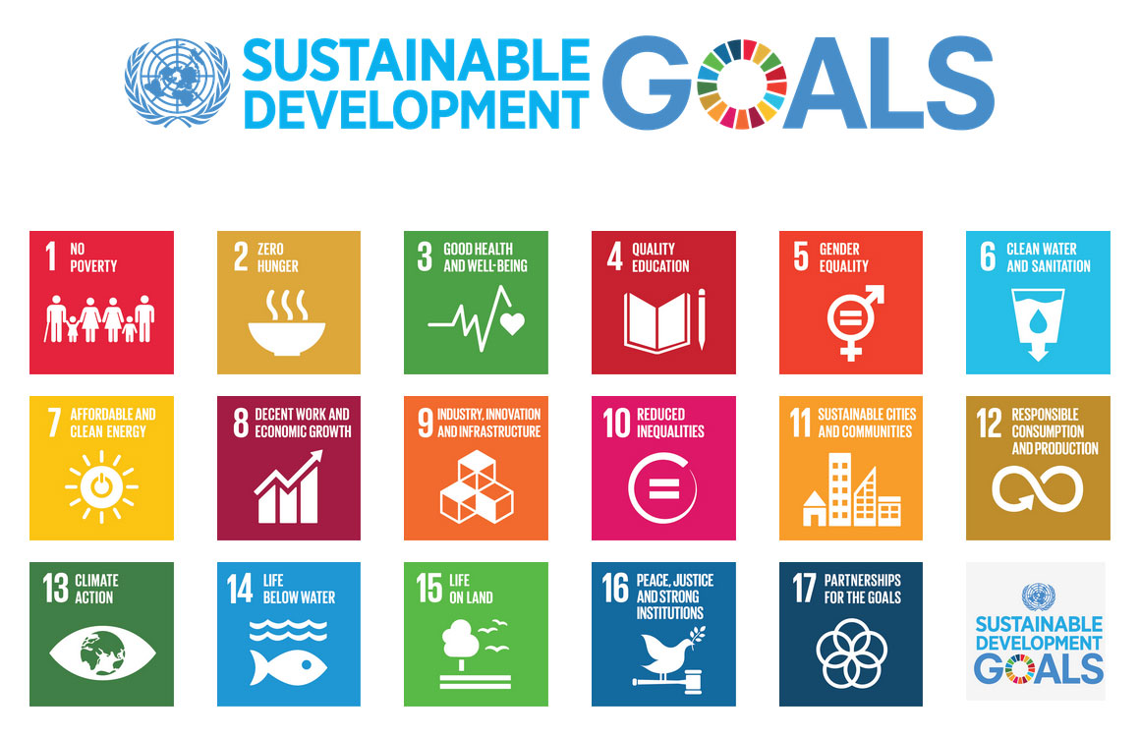

Slide 11

What can we do?

Slide 12
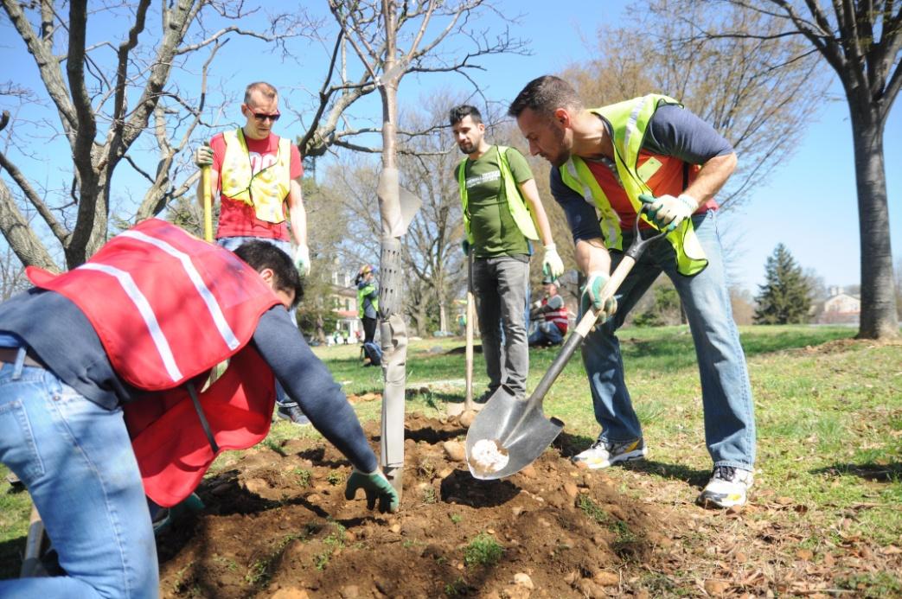
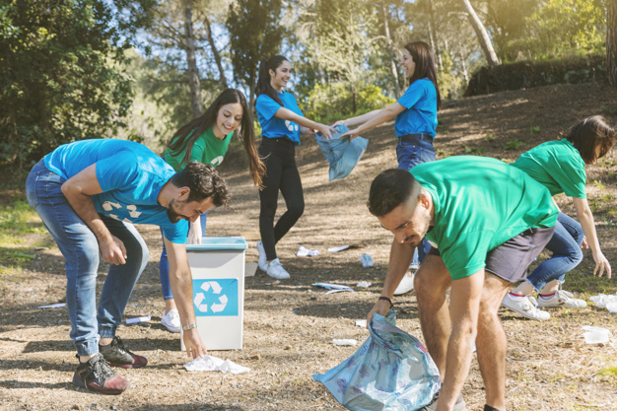
What can we do?

Slide 13
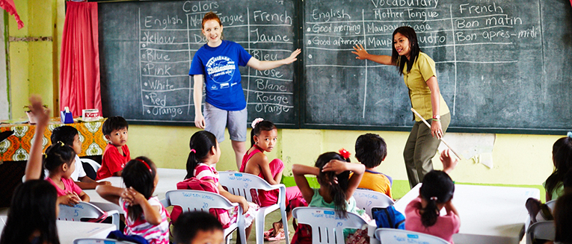
What can we do?

Slide 14

What can we do?

Slide 15

Thank you!

